Slide 1
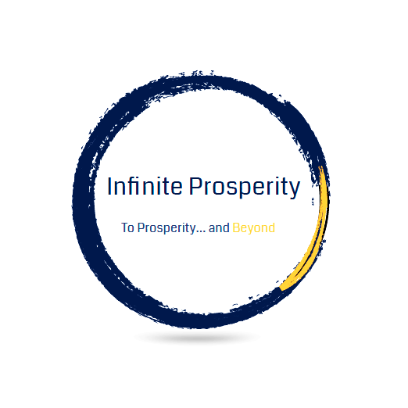
Company Name
Your company tagline

Slide 2

Mission statement:
To create and grow wealth in poor communities through common ownership of critical financial infrastructure utilizing various business models

Slide 3
According to Forbes, 5 of the Main Ways to Create Wealth Are:
Manufacturing
Marketing
Distribution / Retail
Investing
Technology

Slide 4

Manufacturing
Manufacturing is a crucial wealth building model in which companies produce goods through different processes. It involves transforming raw materials into finished products that can be sold in the market. Manufacturing plays a vital role in generating wealth for both individuals and countries, as it contributes to job creation, economic growth, and innovation. Manufacturing is considered a strong wealth creation model that leads to a prosperous nation

Slide 5
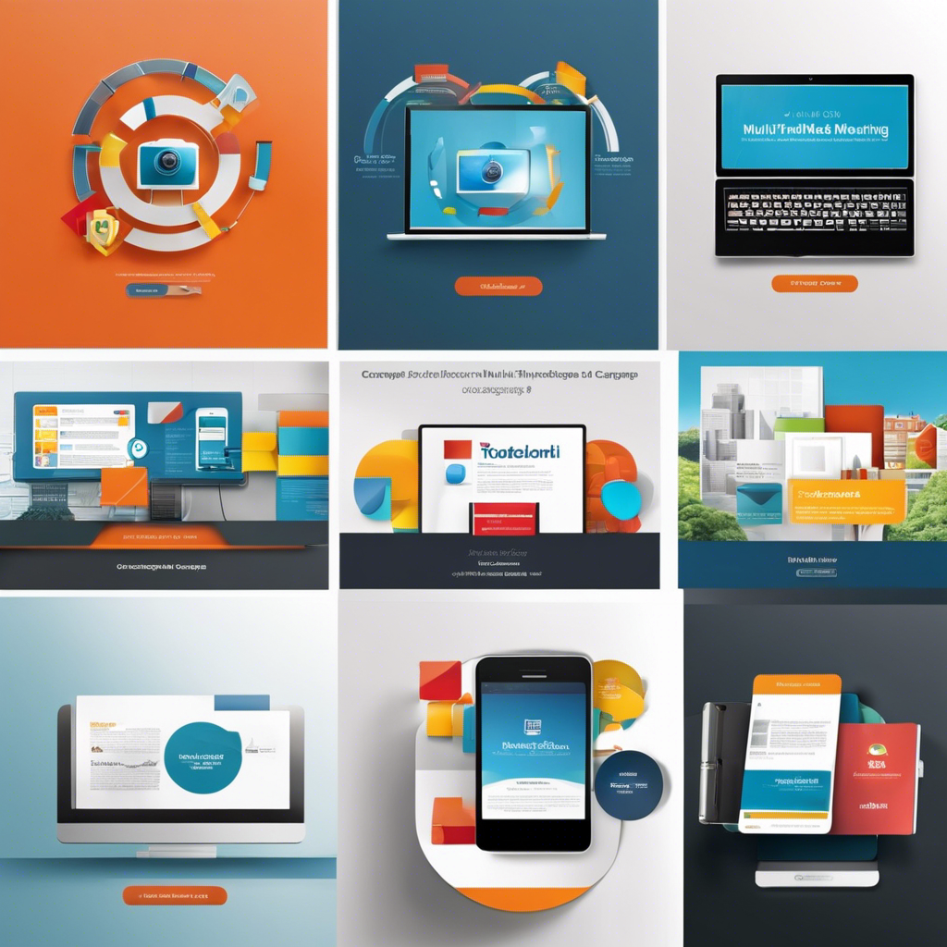
Marketing
Marketing is another impactful wealth building model that focuses on promoting and selling products or services to consumers. Effective marketing strategies can lead to increased sales, brand visibility, and customer loyalty

Slide 6

Distribution / Retail
Distribution is the process of getting products from manufacturers to end consumers. It involves various channels, such as wholesalers, retailers, and e-commerce platforms, to ensure products reach their target market efficiently. Successful distribution can maximize sales and profits. Urban Institute highlights community wealth-building models, which focus on local residents achieving personal financial goals and contributing to residential stability.

Slide 7

Investing
Investing refers to the allocation of money into assets or ventures with the expectation of generating a return or profit. This wealth building model involves putting money in stocks, real estate, mutual funds, or other financial instruments.

Slide 8

Technology
Technology stands as one of the most powerful engines of wealth creation in modern history, transforming ideas into billion-dollar enterprises while generating opportunities across all sectors of society

Slide 9
With the current prevailing business models failing, there has to be a stable alternative strategy to the current wealth building / fundraising process

Slide 10
Although all five models can generate wealth, we focus on Marketing and Distribution for three reasons:
Lower start-up cost to implement
The speed in which these models can be implemented
The amount of money that can be generated in a short period
The other models could be implemented in the future using the funds generated from your marketing and distribution campaigns if your community decides to expand and diversify its wealth building capacity.

Slide 11

Question:
What are the best wealth building models for Marketing, Distribution and Common Ownership to create wealth in poor communities?

Slide 12

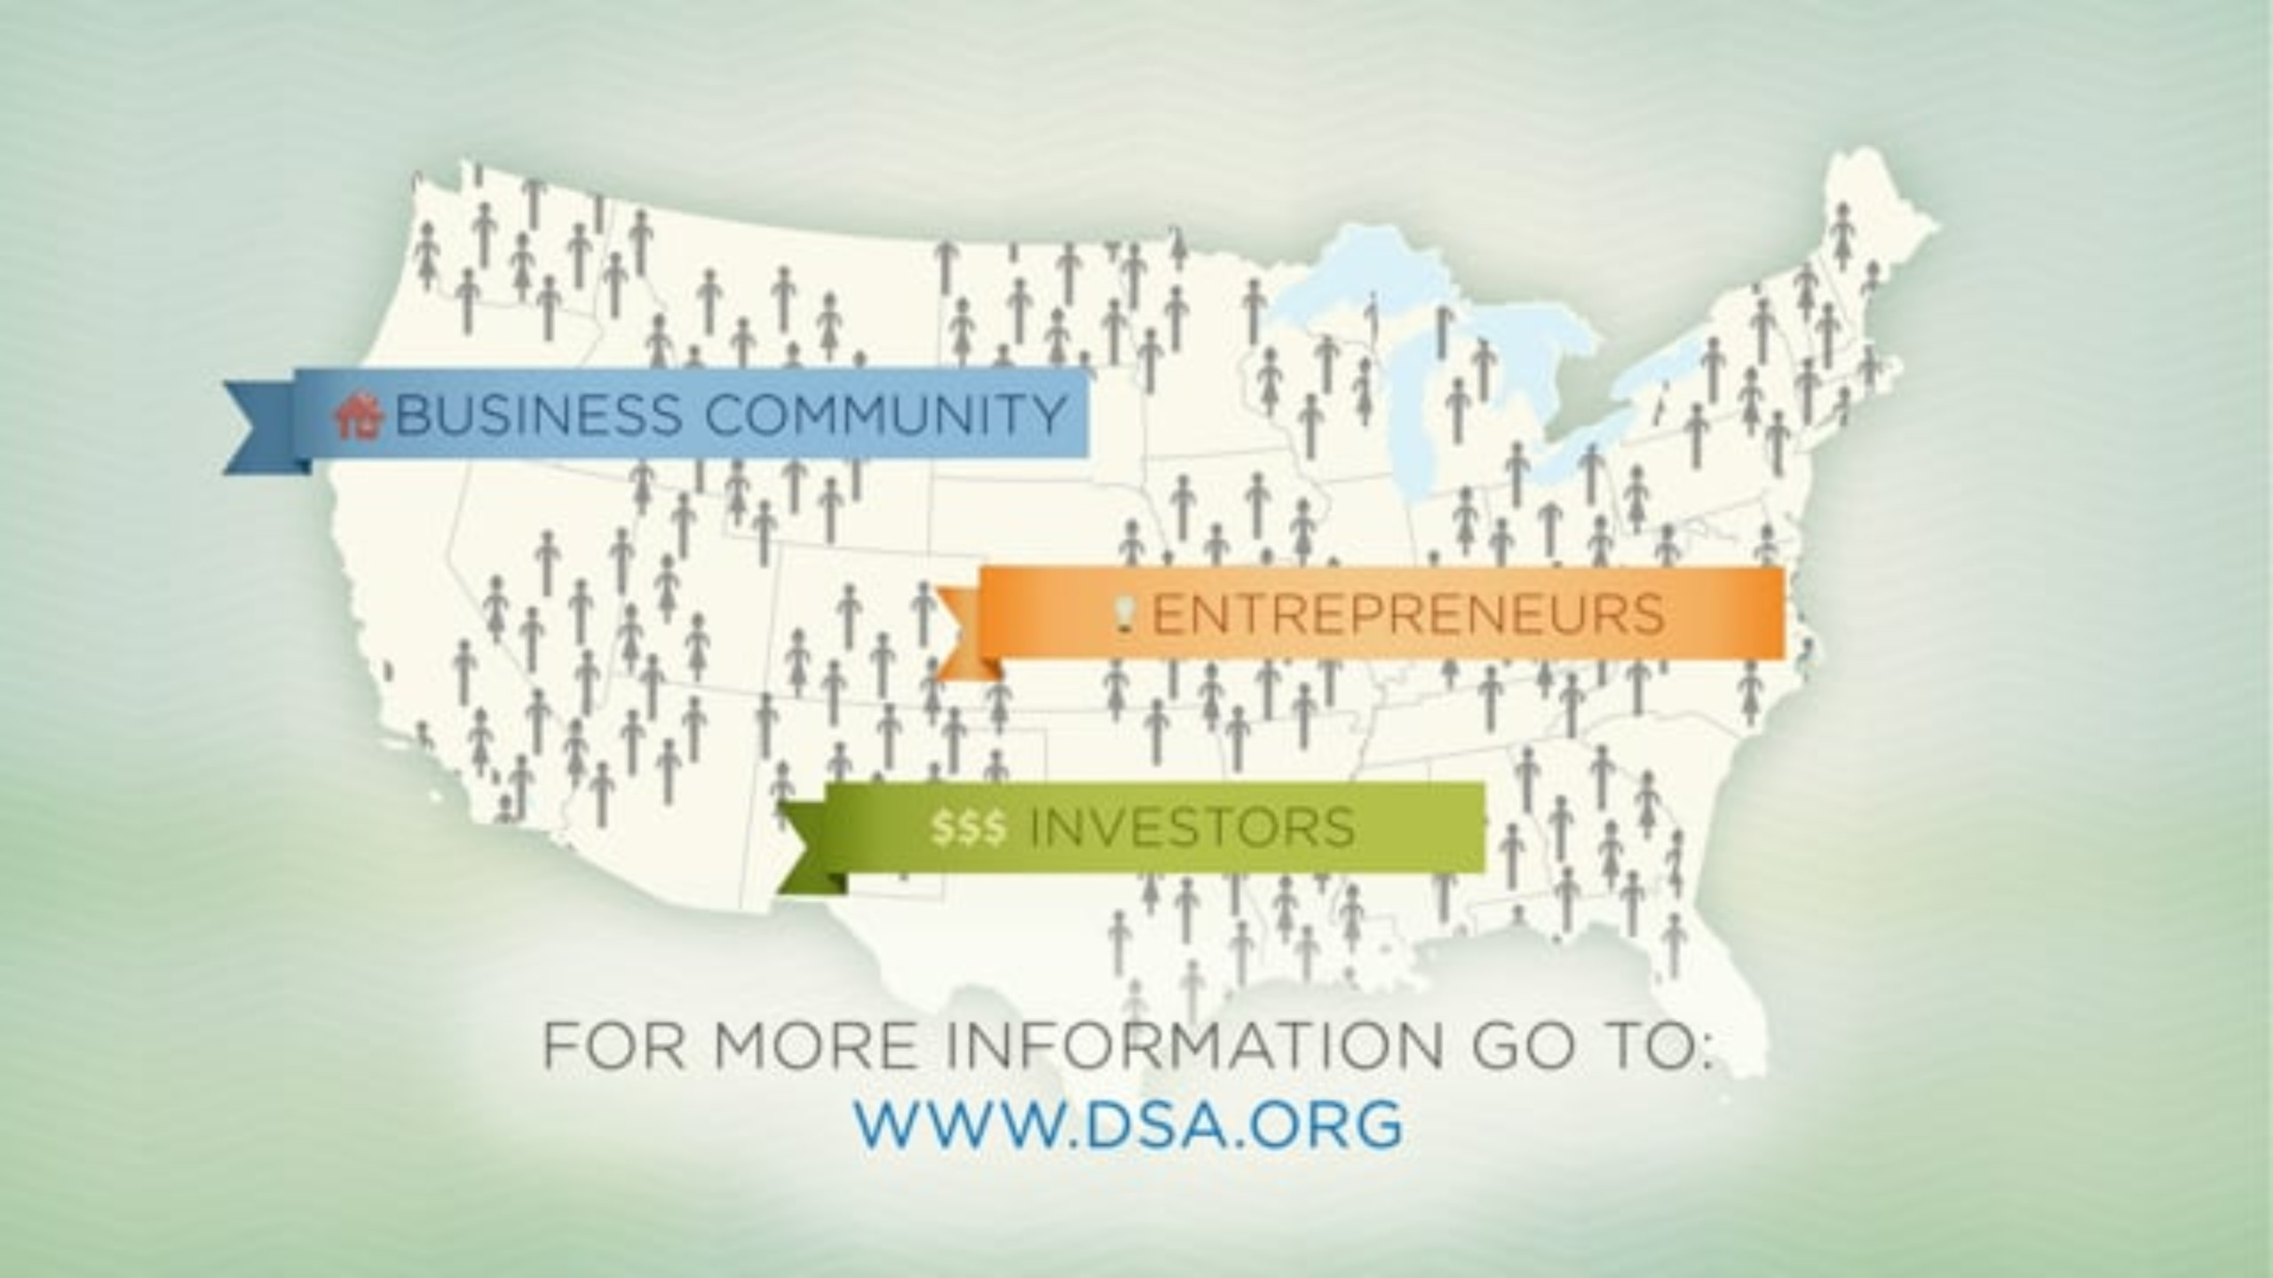
Answer (1): Direct Selling
It combines both models of Marketing and Distribution for the lowest cost and highest ROI.
Video (2:27)---->

Slide 13

Unlock New Revenue Streams
Direct selling partnerships provide a new fundraising and wealth building avenue with sustainable revenues. Let us show you how!

Slide 14
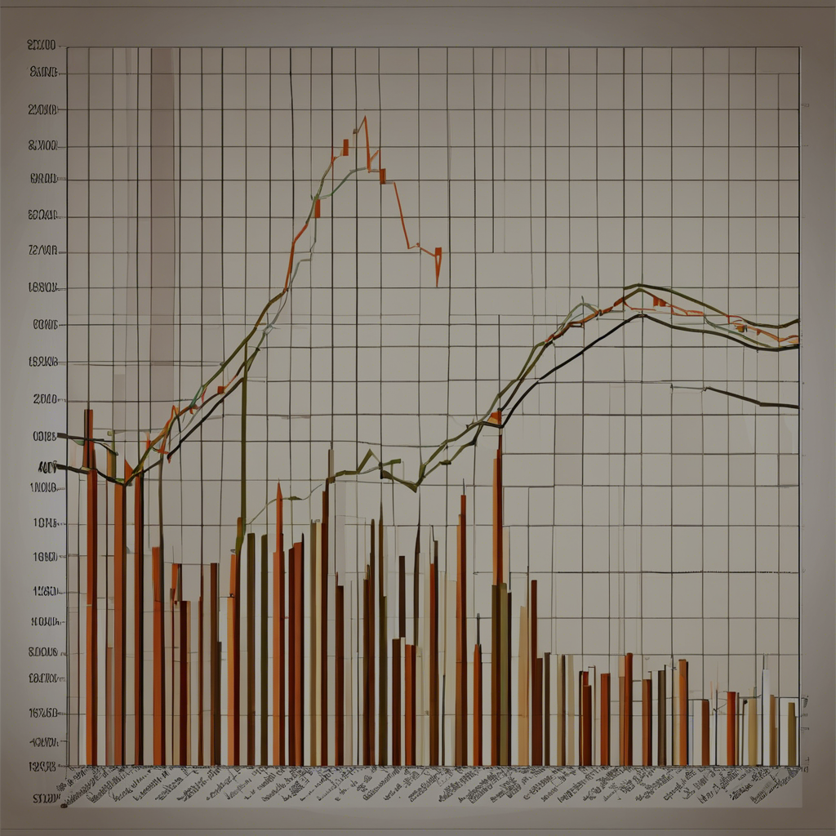
The solution
Declining donations and increased competition have created fundraising challenges for many non-profits. Our direct selling partnerships offer new revenue streams to overcome these obstacles.
Fundraising Challenges? We Have Solutions!

Slide 15






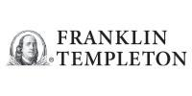
Here are just a few examples of some of our strategic partners…

Slide 16
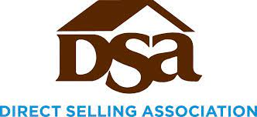

Industry Leaders Ensure Ethics
Associations like the DSA and the DSEF ensure direct selling is conducted legally, ethically and protects consumers.

Slide 17
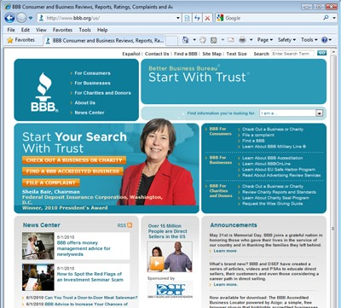
The Direct Selling Education Foundation & Council of Better Business Bureaus Partnership
“DSEF is proud to partner with the Council of Better Business Bureaus (CBBB) to spread our mutual message of ethics and trust in the marketplace. CBBB is the network hub for BBBs in the United States and Canada. Like the Better Business Bureau, CBBB is dedicated to fostering honest and responsive relationships between businesses and consumers, instilling consumer confidence and contributing to a trustworthy marketplace for all.”
Direct Selling Education Foundation

Slide 18
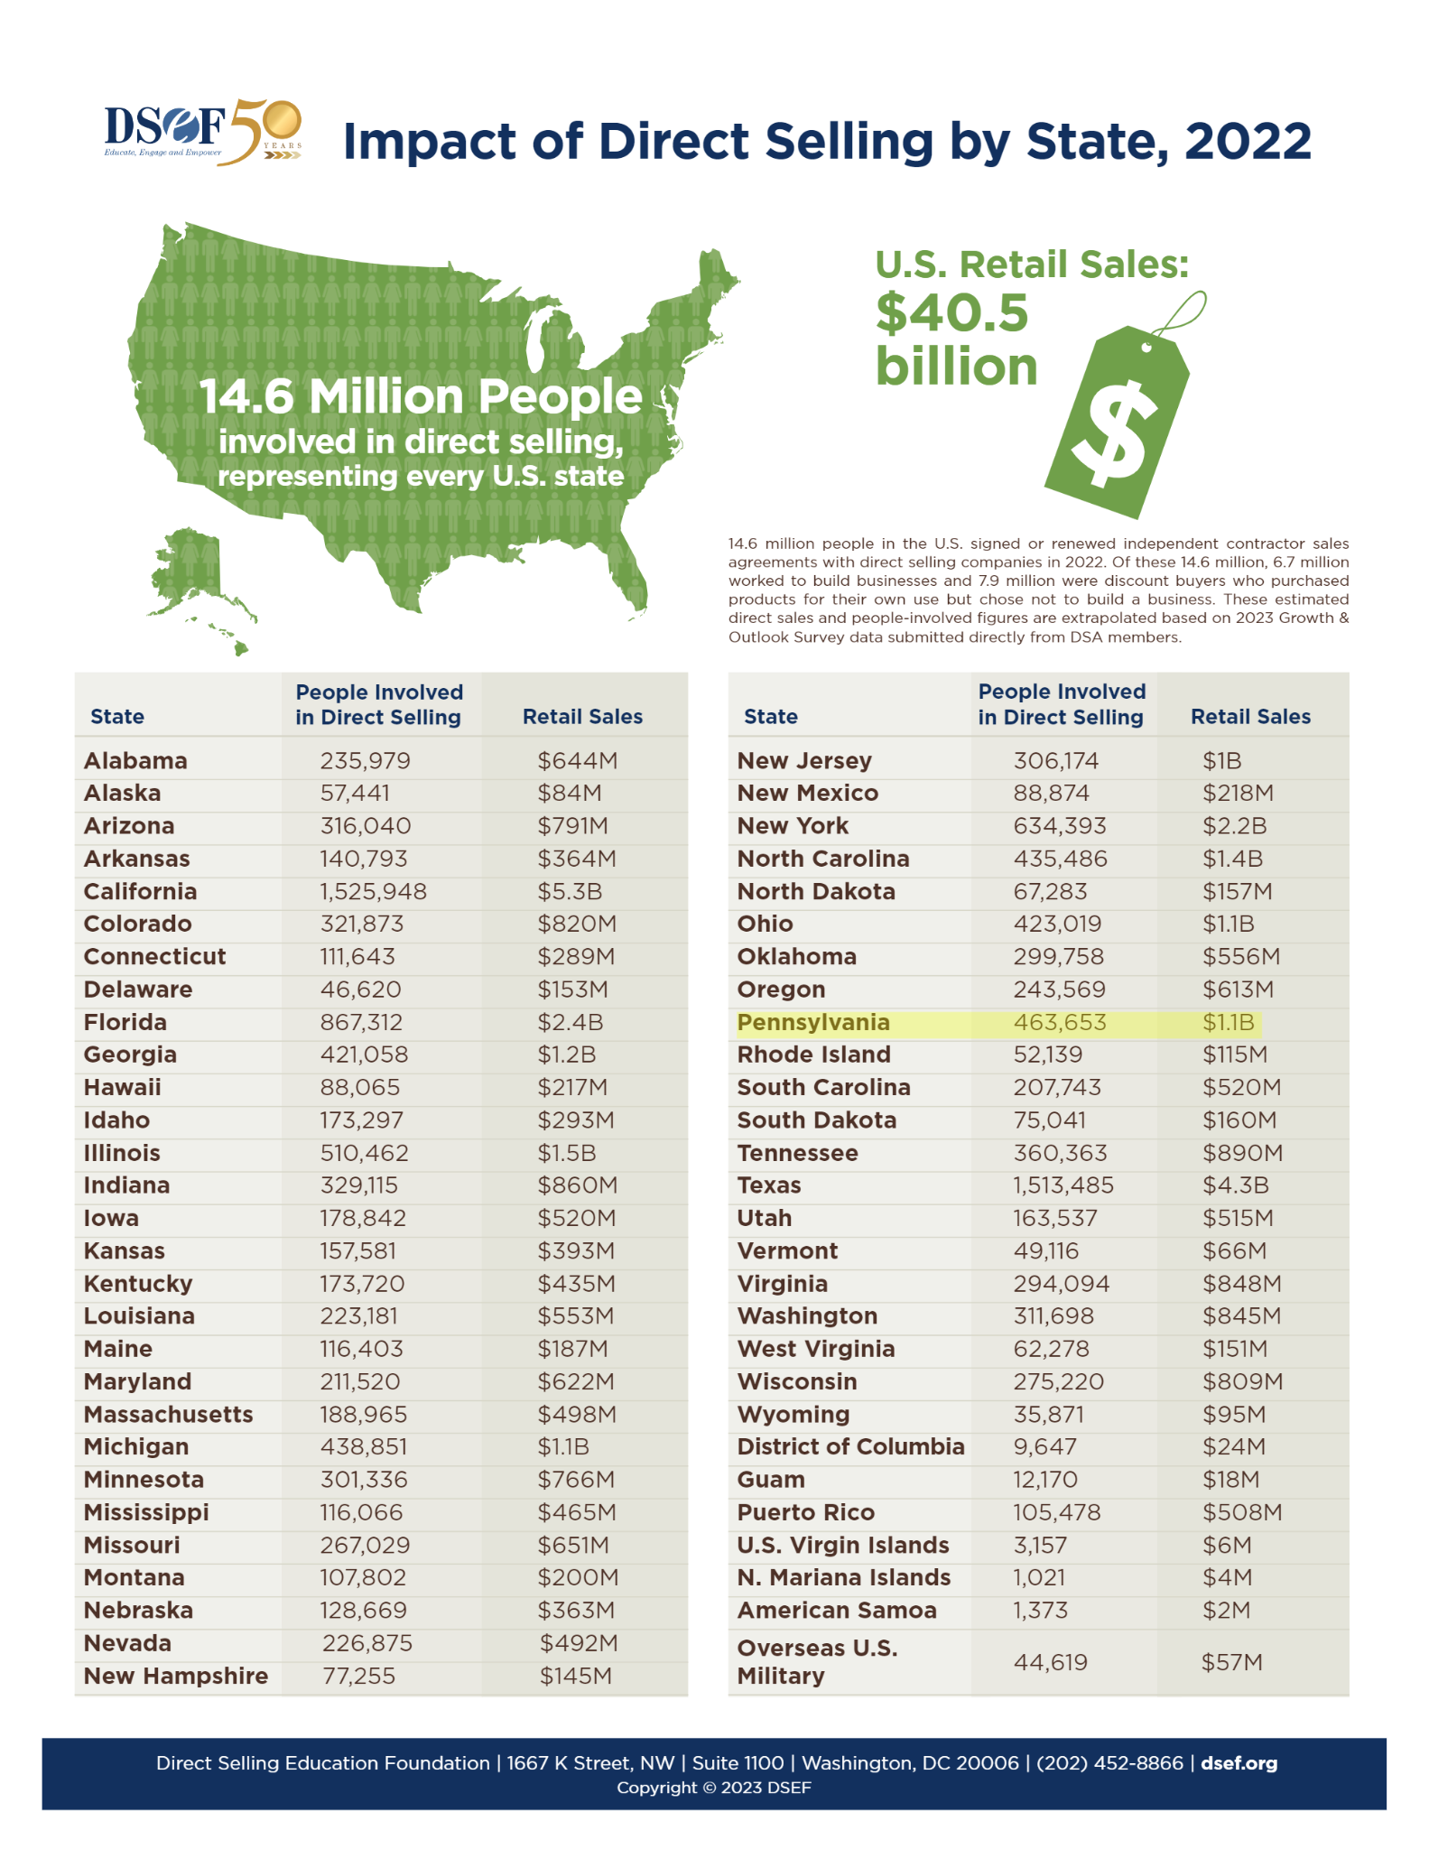
Over a Billion in Sales Driven in Pennsylvania
With over $1.1 billion in annual sales, direct selling delivers results right here in Pennsylvania - that’s money that can benefit local communities and causes.

Slide 19
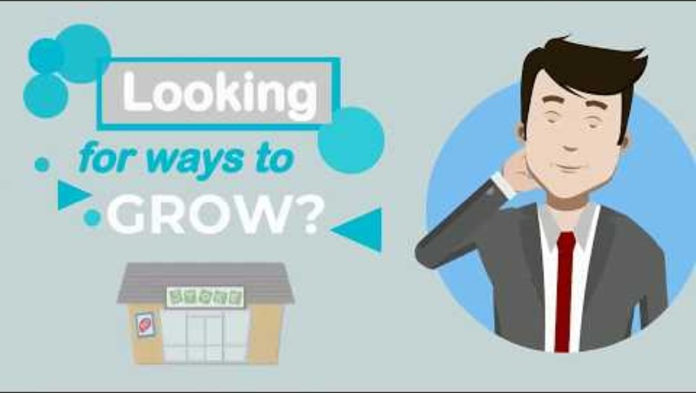
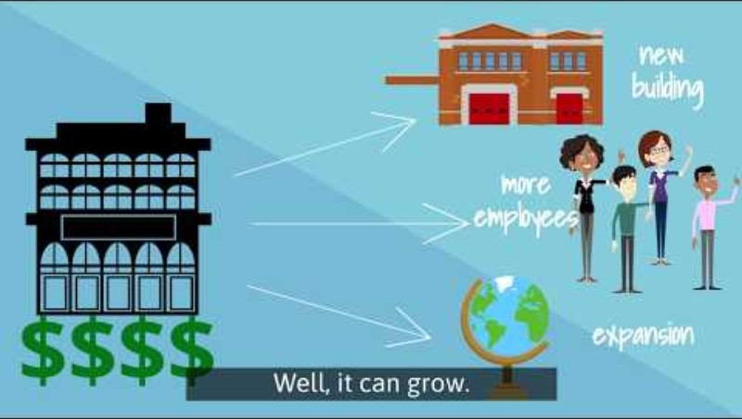
Answer (2): Common ownership like Coops and ESOPs
They give stakeholders the opportunity to own the companies they work for, providing another wealth building tool for communities
Video 1 (2:51) ; Video 2 (1:46)

Slide 20
Employee Ownership: Building Stronger Communities
Pennsylvania Center for Employee Ownership (PaCEO)

Slide 21
Key Statistics

Slide 22
Employee Benefits:
  4x less likely to be laid off
  33% higher income (workers aged 28-34)
  2.5x larger retirement accounts

Slide 23
Business Performance
ESOP Companies Show:
  2.3-2.4% annual sales growth
  25% higher job growth (10-year period)
  8% productivity increase in ESOP adoption year

Slide 24
Community Impact
Local Economic Benefits
  Keeps businesses and jobs in-state
  Builds community wealth
  Prioritizes community giving
Business Succession Solution
  Alternative to private equity sales
  Maintains company integrity
  Offers significant tax benefits

Slide 25
Market Context
Critical Numbers
  4.5M businesses will transact in next 10 years
  70% of owners lack succession plans
  56% of Americans over 55 have <$50k in retirement savings

Slide 26
We’ve identified two powerful business models to build wealth quickly.
Q: How do we market our model to stakeholders and the community at large?

Slide 27
A: Cause Marketing

Slide 28

What is Cause Marketing?
Cause marketing aligns a nonprofit's or community organiztion’s mission with a company's products - raising awareness while generating sales. This model involves creating strategic partnerships based on a mutual alignment of values and missions. It can involve a wide range of activities, including marketing campaigns, social media promotions, sponsorship deals, and product collaborations.

Slide 29

Cause Marketing - Promote Your Cause to Conscious Consumers

Slide 30

Is Cause Marketing Effective?
According to the 2019 Porter Novelli/Cone Purpose Biometrics Study, 72% of Americans say it’s important to them that the companies they buy from reflect their values and 86% say they’re likely to purchase from purpose-driven companies. Which in turn, also offers a massive benefit to the associated communities and nonprofits.

Slide 31
Examples of Successful Cause Marketing Campaigns

Slide 32
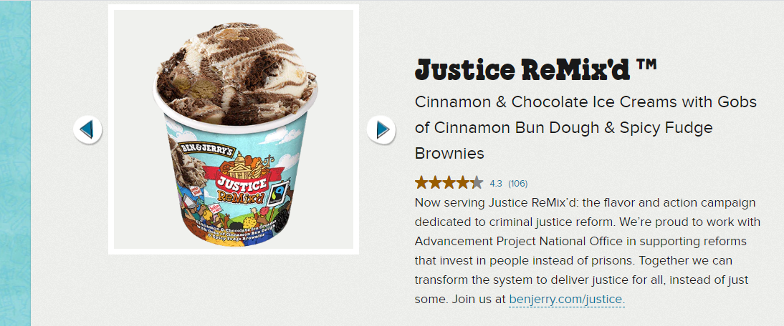
Ben and Jerry’s Justice ReMix’d
Ice cream company Ben and Jerry’s has partnered with the Advancement Project National Office to raise awareness about criminal justice reform. A portion of proceeds from their Justice ReMix’d flavor go to the Advancement Project, and the company provides education and action suggestions to their customers. The Advancement Project National Office promotes the partnership with the hashtag #JusticeRemixd.

Slide 33
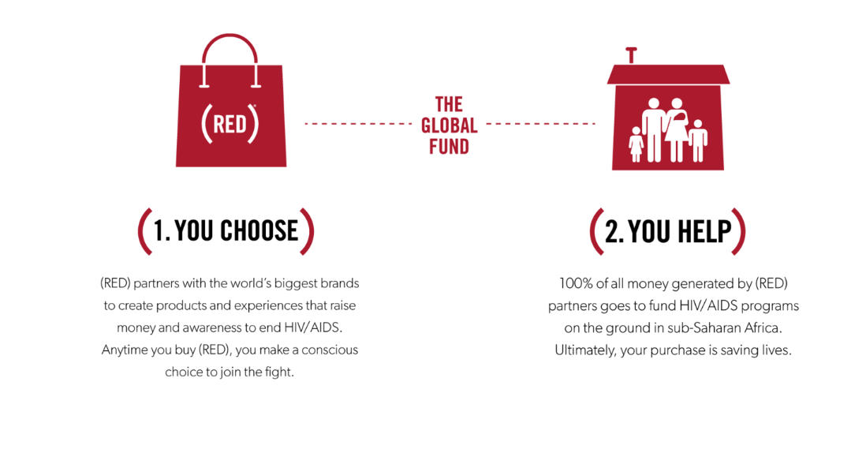
The (RED) Campaign
(RED) partners with brands to create products and experiences to raise money to fight HIV/AIDS. Companies create (RED) versions of their products, and the proceeds go to a global fund that makes grants to HIV/AIDS organizations.

Slide 34
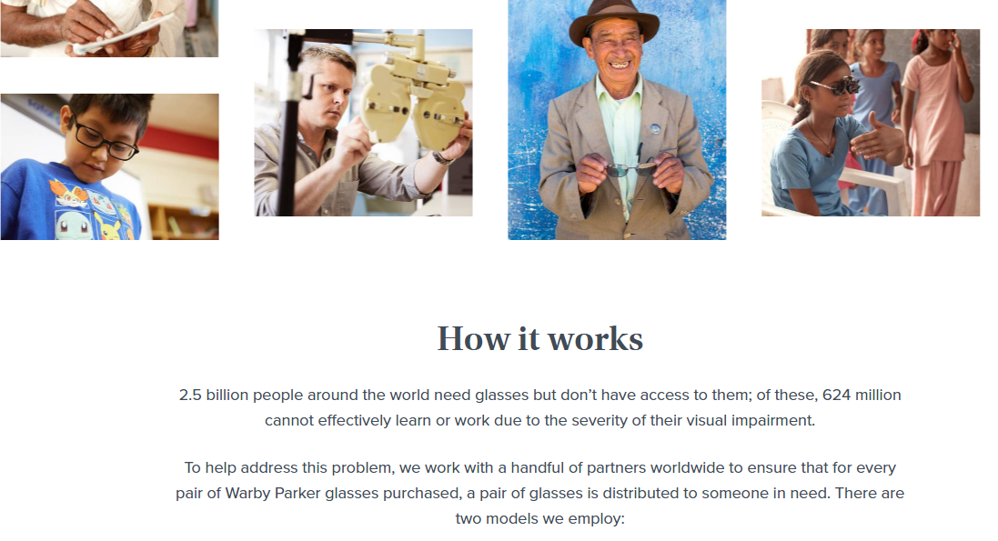
Warby Parker “Buy a Pair, Give a Pair”
Optical company Warby Parker partners with social enterprise Vision Spring to donate a pair of glasses for every pair they sell. Warby Parker gets the image boost of helping, while Vision Spring gets more resources to do their work.

Slide 35

Maximize Your Reach Nationwide
You can partner and collaborate with other communities and non profits nationwide to maximize your ROI. The National Center for Charitable Statistics (NCCS) states that there are more than 1.8 million non profit organizations, and Cause IQ states that there are as many as 21,000 Community Development Organizations registered in the US

Slide 36


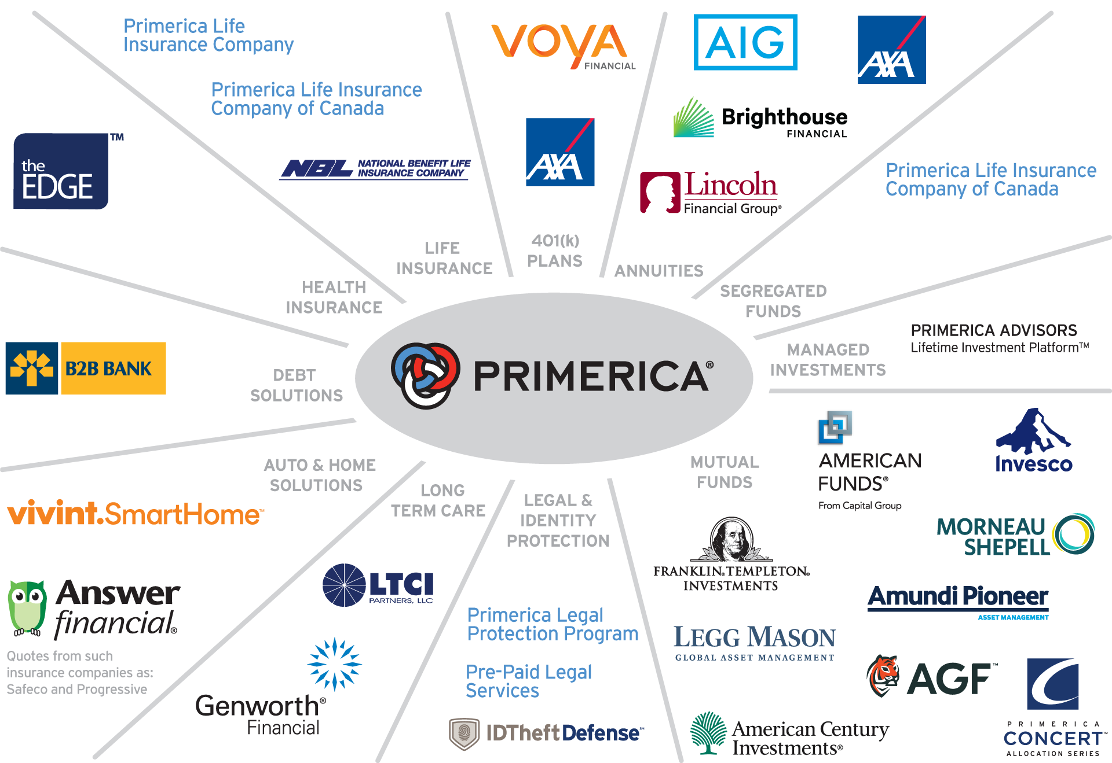
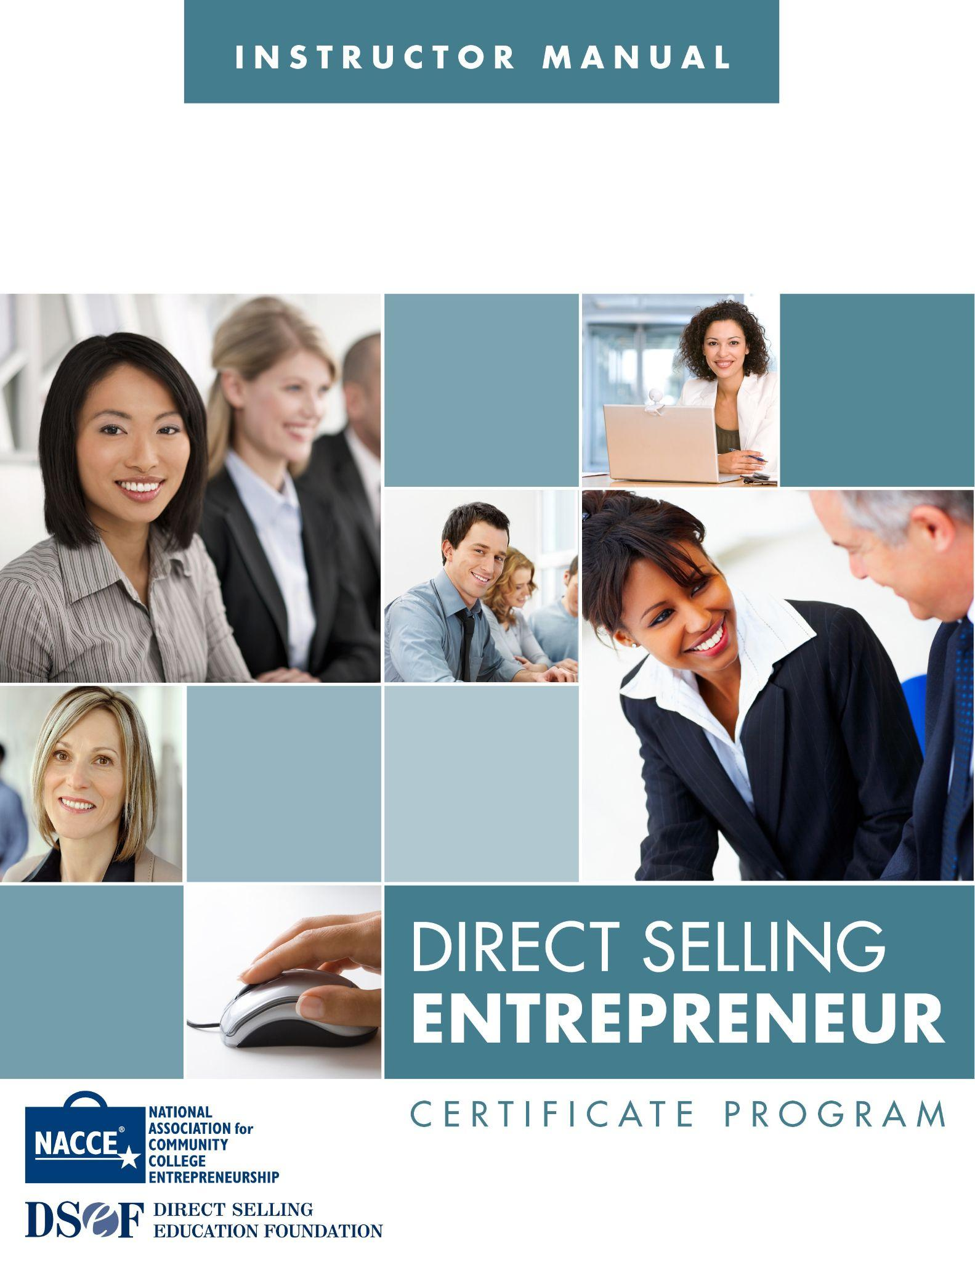
To Summarize
You can create new sustainable revenue to your community and organizations by partnering with us. We will help you:
Connect with reputable direct selling companies to partner with
Develop your cause marketing campaign
Train supporters to become social entrepreneurs supporting your organization
Connect with other organizations to multiply revenue to your community and organizations

Slide 37
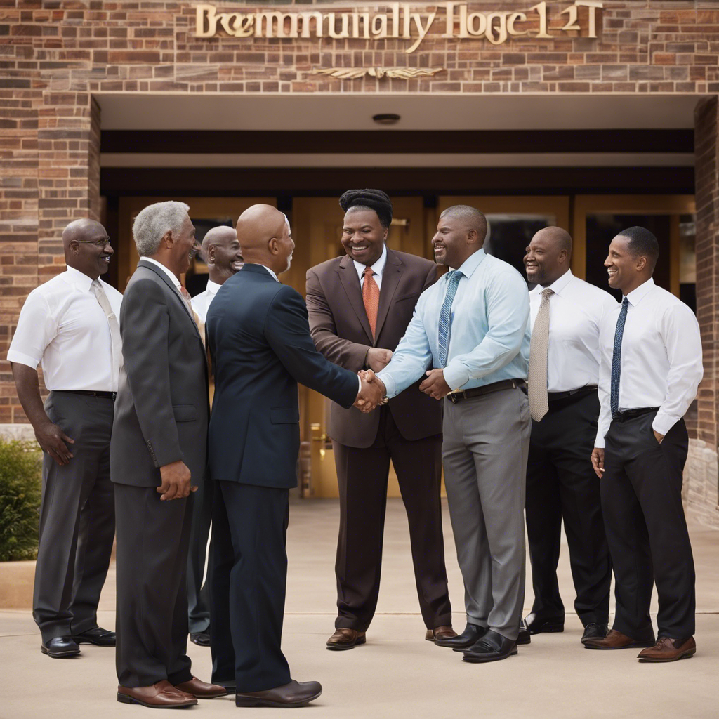
Let’s Get to Work!
Together we can make wealth building and funding worries for your community and organizations become a thing of the past!

Slide 38
“If you want to go fast, go alone. If you want to go far… Go together”
African Proverb

Slide 39

Thank You For Your Time
Bill Bailey
President - Infinite Prosperity
724-328-0507
bbailey@infiniteprosperity.org

